Slide 1
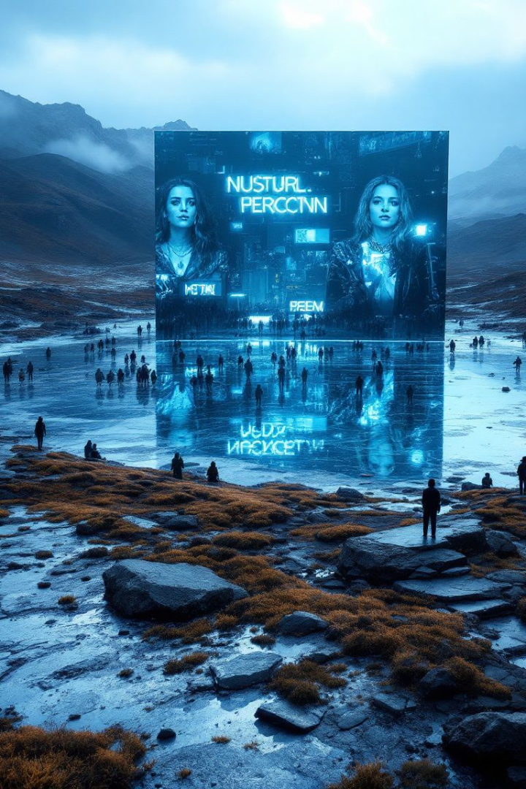

The Media's Mirror: Shaping Public Opinion in the Digital Age
Explore how media constructs our understanding of the world. Examine misinformation's impact. Learn essential media literacy skills. Navigate the digital age responsibly.
by Himanshu

Slide 2
Agenda-Setting and Framing
Agenda-Setting
Framing
Media highlights issues. It tells us what to think about.
Media presents information. This shapes our interpretation.
Crime coverage shapes safety perception. This happens regardless of actual stats.
"Tax relief" vs. "tax cuts for the wealthy". These frame economic policy.
70% of Americans think crime is rising. Data shows a decline since the 1990s.
Framing shifts public support by 20-30%.

Slide 3
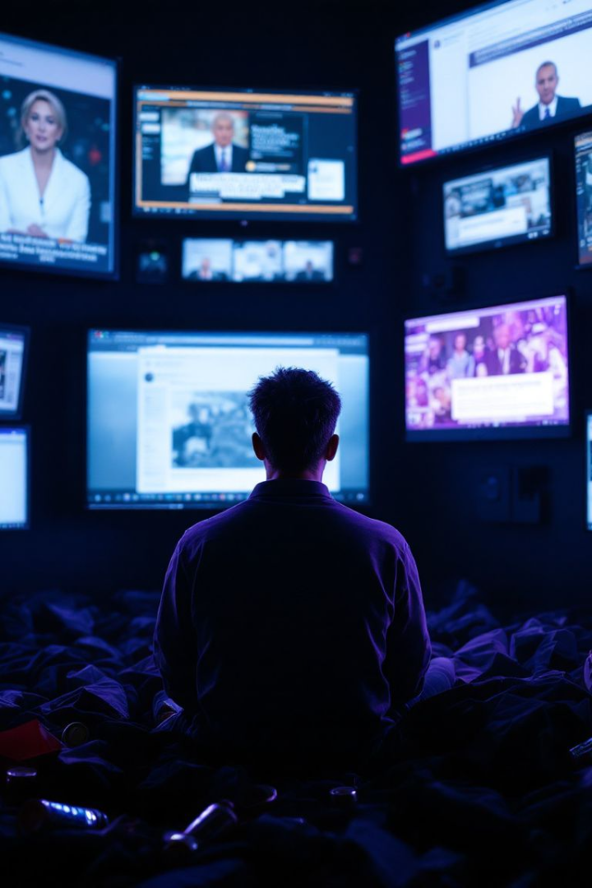



The Echo Chamber Effect
Selective Exposure
Filter Bubbles
Algorithms limit exposure to diverse views. This personalizes content.
People seek media aligning with beliefs. This reinforces existing views.
Confirmation Bias
Favor information confirming beliefs. This can cause division.

Slide 4
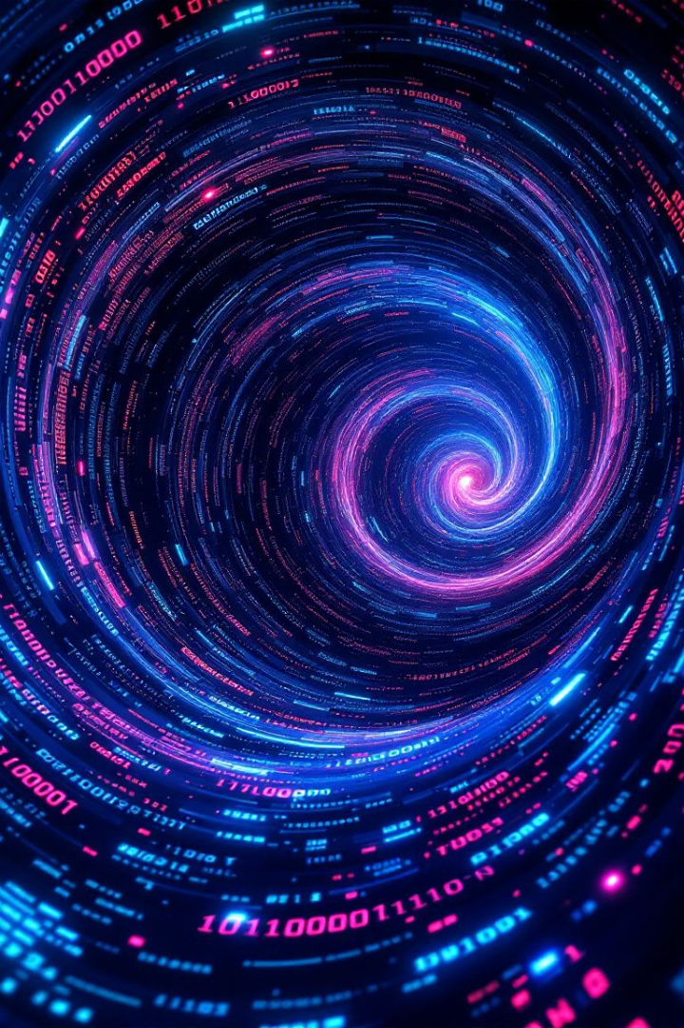
The Rise of Misinformation
Fake News
Disinformation
Fabricated content presented as genuine news. Deception is the goal.
Deliberate spread of false information to deceive. An intentional manipulation.
Misinformation
Unintentional spread of inaccurate information. Sharing unverified claims.

Slide 5
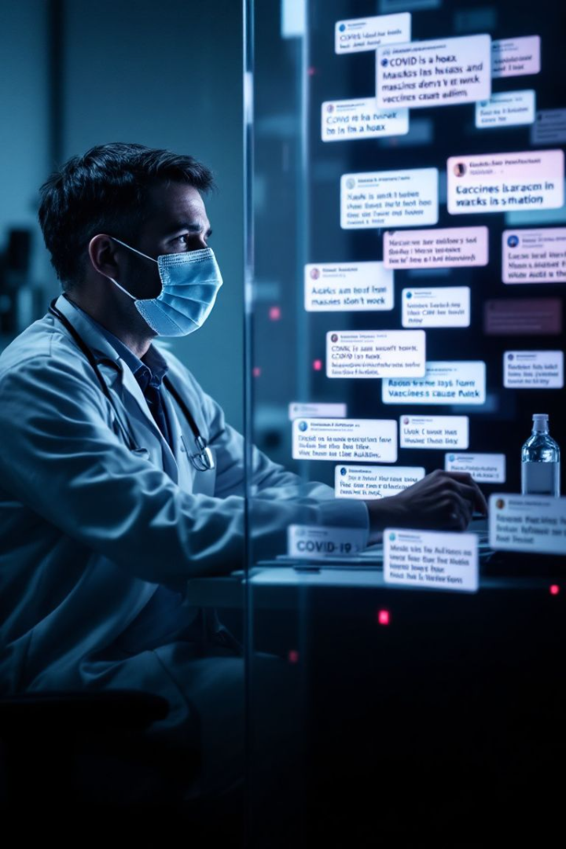



Case Study: COVID-19 Misinformation
False cures and conspiracy theories spread quickly.
Public health and vaccination rates were impacted. Belief in misinformation lowers vaccination intent.
Social media fought misinformation. Platforms removed millions of pieces of false content.

Slide 6
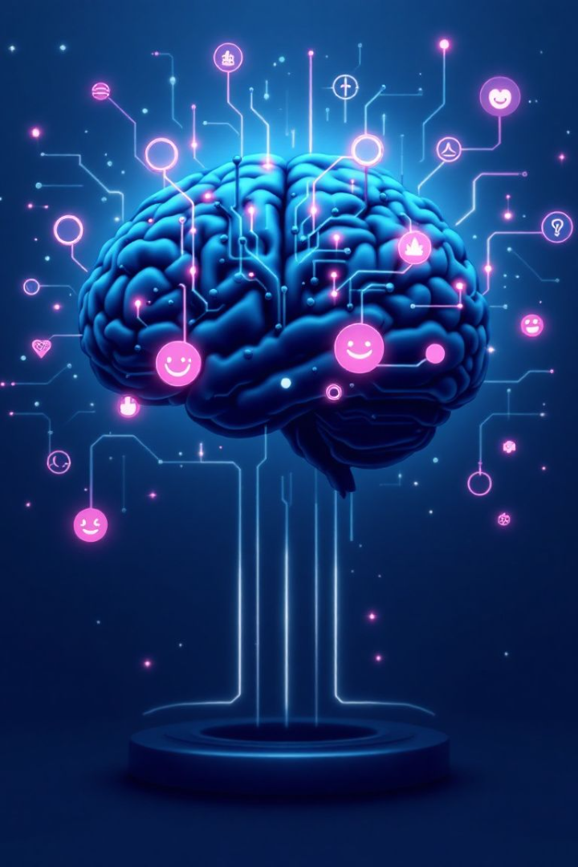


Psychological Factors in Misinformation
Cognitive Biases
Systematic errors in thinking. These include availability and affect heuristics.
Source Credibility
Trusting information from perceived experts. False experts promote unproven treatments.

Slide 7



Social Media Algorithms
Microtargeting
2
Messages are tailored to specific audiences.
Amplification
1
Sensational content engagement gets prioritized.
Bots and Trolls
Automated accounts spread misinformation.
3

Slide 8



Combating Misinformation
Critical Thinking
1
Evaluate sources and evidence.
Lateral Reading
2
Verify info across sources.
Awareness
3
Recognize cognitive biases.

Slide 9
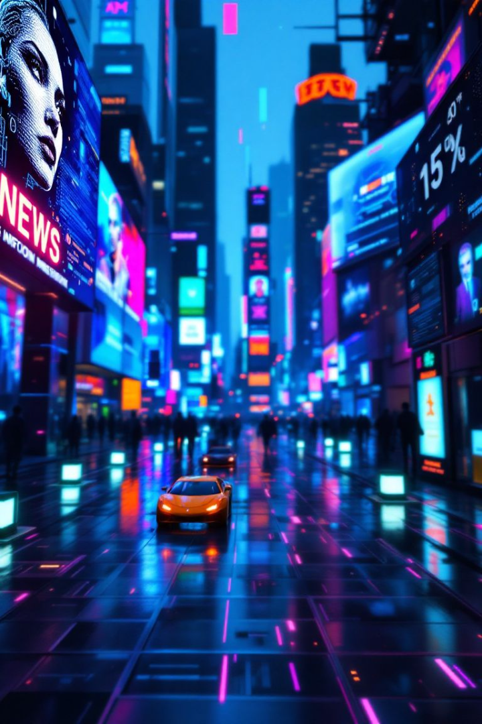
The Future of Media Influence
AI
Blockchain
AI
Decentralization
AI and deepfakes are increasing misinformation sophistication.
Decentralized media presents challenges and opportunities. Blockchain platforms improve transparency.
Ethics
Ethics
Responsible journalism and strong ethics are needed.

Slide 10
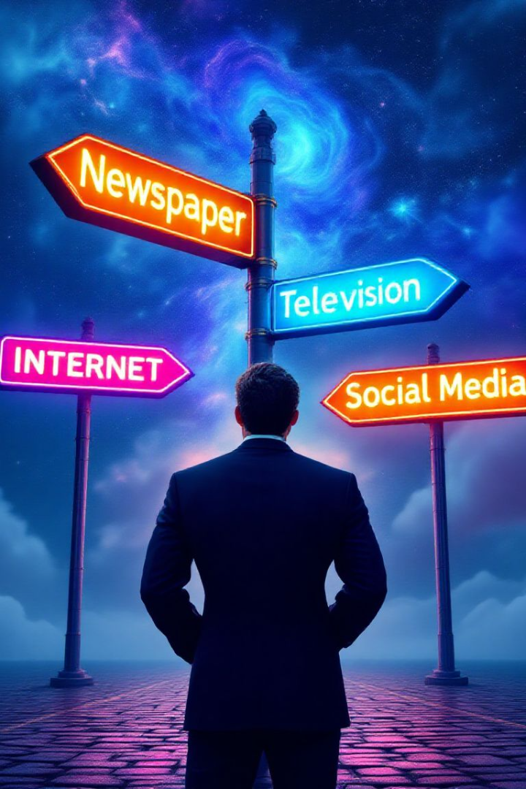
Navigating the Media Landscape
Media shapes public opinion. Misinformation threatens informed decisions. Media literacy is essential. Consume media responsibly.

